Slide 1

E.G.S. Pillay Engineering College
An Autonomous Institution Affiliated to Anna University, Chennai | Approved by AICTE, New Delhi
Accredited by NAAC with A++ Grade | Accredited by NBA T1 (B.E. – CIVIL,MECH,EEE,CSE,ECE & B.Tech – IT)
Old Nagore Road, Thethi, Nagore Village, Nagapattinam – 611002, Tamil Nadu, India
ELECTRONICS AND COMMUNICATION ENGINEERING
Vehicle Speed Monitoring and Wildlife Protection System in Forest Areas
Date& Session : 30.01.2026
Presented by,
S. NITHISHKUMAR(8208E23ECR064)
P. SRIRAM(8208E23ECR104)
M. SRITHARAN(8208E23ECR105)
N. THIRUMURUGAN(8208E23ECR114)
Guided by,
Mrs.S.VETRISELVI,M.Tech.,ph.D.

Slide 2
ABSTRACT
Vehicle accidents in forest areas endanger wildlife and human lives due to over-speeding and lack of awareness. This system monitors vehicle speed and detects animal movement near roads to provide timely warnings to drivers. It helps reduce accidents, protect wildlife, and improve road safety in forest regions.
2/13

Slide 3
Introduction
Forest roads often face accidents due to over-speeding and unexpected wildlife crossings. The Vehicle Speed Monitoring and Wildlife Protection System helps monitor vehicle speed and detect animal presence near roadways. This system improves driver awareness, reduces accidents, and supports wildlife safety.
3/13

Slide 4
PROBLEM STATEMENT
Over speeding vehicles in forest areas cause frequent wildlife accidents, requiring an automated speed monitoring and alert system.
4/13

Slide 5
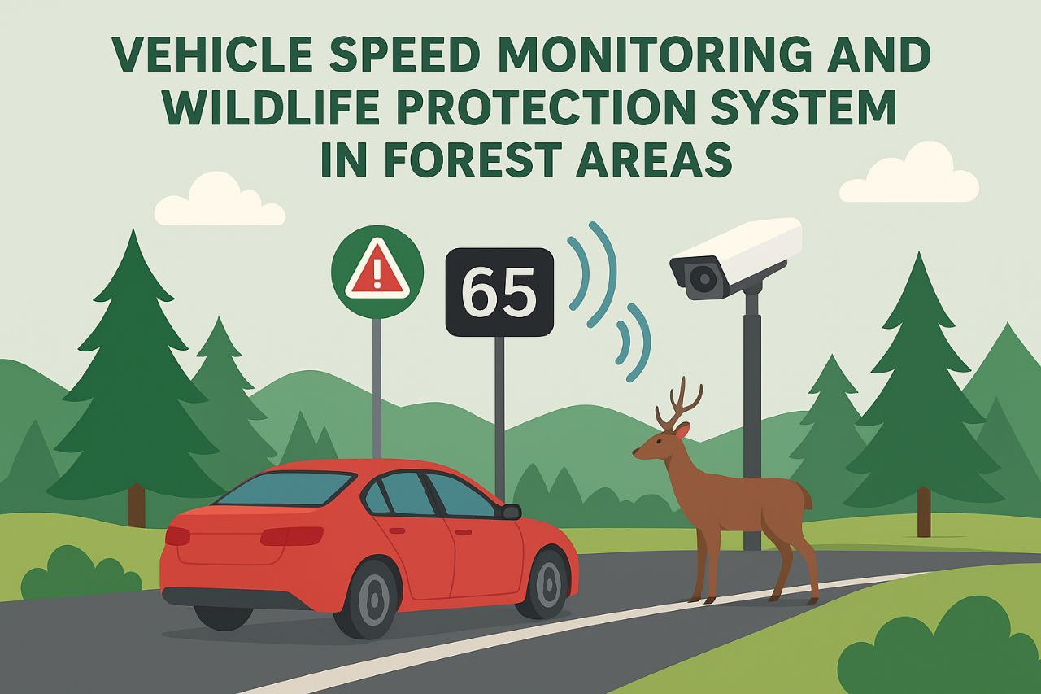
5/13

Slide 6
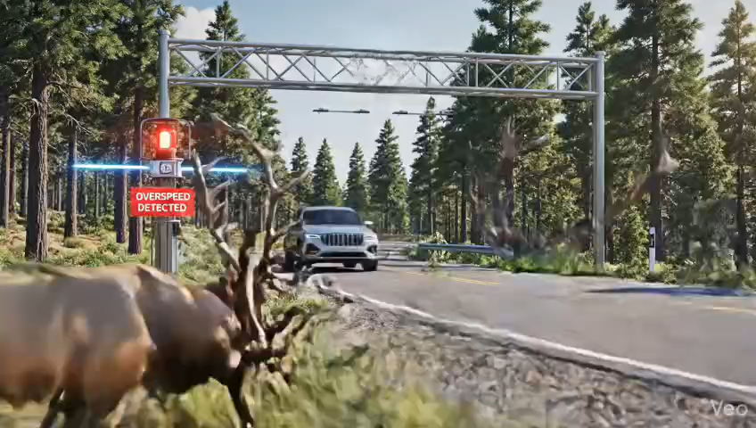
Visual Explanation

Slide 7
Objectives
Monitor vehicle speed automatically.
Alert drivers when speed exceeds limits.
Detect wildlife and notify forest officials.

Slide 8
Components
Microcontroller: Arduino Uno
Sensors: IR Sensors, Ultrasonic Sensors, or LIDAR for vehicle detection
Camera (optional): For number plate or animal detection
LCD Display: Shows vehicle speed and alerts
Buzzer / LED Indicator
GSM Module (SIM800L)
Solar Panel (optional): Provides renewable energy in remote zones
8/13

Slide 9
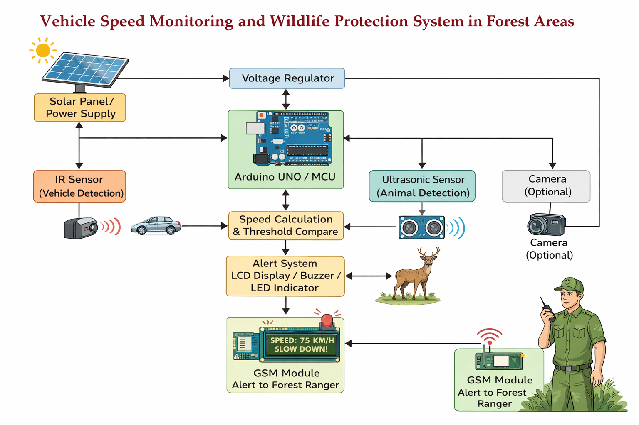
Block diagram
9/13

Slide 10
Methodology
System Setup
Vehicle Detection
Speed Measurement
Speed Comparison
Alert Generation
Data Logging (optional)
Power Management
10/13

Slide 11
System Operation and Setup
System Installation:
Sensors positioned at equal distances along forest roads.
Weatherproof casings protect against rain and dust.
Connected to control unit wirelessly or via cables.
Vehicle Detection:
IR/Ultrasonic sensors detect vehicle motion.
Arduino Uno receives sensor input to start timing sequence.
Speed Measurement:
Speed = Distance / Time between two sensors.
Accurate calculation ensures proper speed detection.
Speed Comparison:
Speed is compared to a preset limit (e.g., 40 km/h).
Overspeed → alert event triggered.

Slide 12
Alert, Data, and Power Management
Alert Generation:
Buzzer and LED flash as driver warnings.
LCD displays message 'Slow Down – Wildlife Zone Ahead'.
DFPlayer Mini plays voice alerts.
GSM module sends message to forest authorities.
Data Logging and Analysis:
Stores vehicle speed, date, and time.
Data helps analyze overspeed trends.
Power Management:
Solar panels provide sustainable energy.
Battery backup ensures night operation.

Slide 13
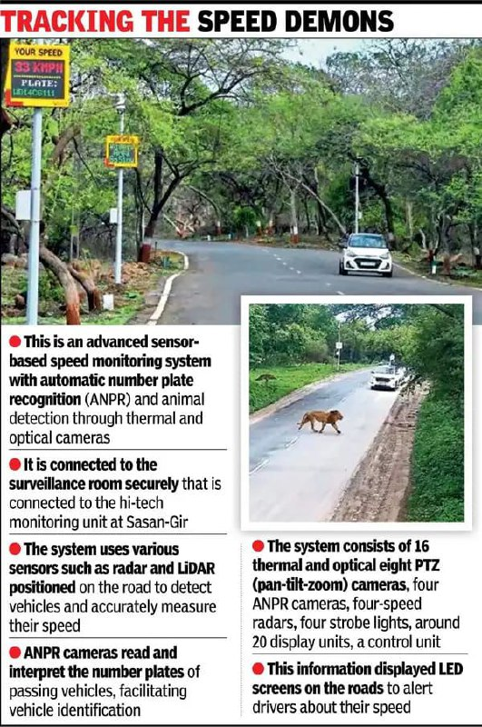
Existing Real-Life Implementation
Gir National Park (Gujarat): The Gujarat forest department has launched a pilot project using advanced sensor-based speed monitoring systems and thermal and optical cameras for animal detection to prevent wildlife-vehicle collisions.
13/13

Slide 14
Limitations of Existing Methodology
Accuracy of sensors and cameras in detecting wildlife and vehicles in varying conditions (like fog, heavy rain, or low light).
Effectiveness of alert systems in grabbing drivers' attention in time.
Reliability of ANPR cameras in logging overspeeding vehicles with varying number plate designs or conditions.
Maintenance and upkeep of tech in remote forest areas.
14/13

Slide 15
Overcome of our project
Multi-Modal Alerts: Implement alerts that combine visual, auditory, and tactile cues to grab drivers attention effectively.
Integration with Existing Infrastructure: Integrate speed monitoring systems with existing infrastructure, such as traffic management systems.
Data-Driven Insights: Analyze data from speed monitoring systems to gain insights on traffic patterns and wildlife behavior.
Regular Calibration: Regularly calibrate sensors to ensure optimal performance and accuracy.
15/13

Slide 16
Advantages of our Project
Prevents wildlife accidents by enforcing speed limits.
Low-cost and easy-to-deploy solution compared to radar systems.
Real-time monitoring and alert system.
Environment-friendly with solar power option.
Can be scaled for highways, villages, and other sensitive zones.
Reduces human-animal conflict, aiding conservation efforts.
16/13

Slide 17
Review of literature
Sl. No | Author Name & Year | Study Area / Journal | Title of the Paper | Advantages / Key Findings | Limitations | Future Work / Suggestions | Link (for Reference)
1 | Knyva, M. et al. (2023) | IEEE Access Journal | IoT Sensor Network for Wild-Animal Detection Near Roads | Developed a low-power IoT sensor network using ultrasonic sensors and wireless modules for real-time wildlife detection; achieved >90% detection for large animals. | Limited range for small animals; performance drops during heavy rain or dense foliage. | Integrate thermal imaging and AI-based classification for better detection accuracy. | IEEE Xplore Link
2 | Chen, J. et al. (2022) | Sensors (MDPI) | Deer Crossing Road Detection with Roadside LiDAR Sensor | Demonstrated LiDAR’s capability for detecting and tracking deer up to 30 m range; robust under low light. | High cost of LiDAR units and complex data processing pipeline. | Use of hybrid LiDAR + camera system to balance cost and performance. | MDPI Sensors
3 | Huijser, M.P. et al. (2021) | Western Transportation Institute Report | Evaluation of Animal Detection Systems for Wildlife-Vehicle Collision Reduction | Field-tested radar and infrared detection systems; found dynamic warning signs reduce vehicle speed and collision rates significantly. | False alarms from vegetation and small animals caused driver desensitization. | Improve machine learning filtering and conduct long-term maintenance studies. | WTI Report

Slide 18
Thankyou!
18/13

